Slide 1
R.M.K. ENGINEERING COLLEGE (An Autonomous Institution) R.S.M. NAGAR, KAVARAIPETTAI, GUMMIDIPOONDI TALUK, THIRUVALLUR DIST. - 601206. Affiliated to Anna University, Chennai / Approved by AICTE, New Delhi /Accredited by NAAC with A+ Grade/ ISO 9001:2015 Certified Institution /All the eligible UG programs are accredited by NBA, New Delhi. Website: www.rmkec.ac.in
Department of Electronics and Communication Engineering
USER-FRIENDLY AI HARDWARE FOR EV CHARGING USING RFIDs
BY:
Ommina Masthan Murali – 111719106106
Bala Srinivas S – 111719106017
Suman chaitanya. Ch – 111719106027
Yogavardhan C - 111719106026
Under the guidance of
Dr. Sumitra V (M.E., Ph.D) – AP/ECE

Slide 2


USER-FRIENDLY AI HARDWARE FOR EV CHARGING USING RFID

Slide 3
OBJECTIVE
To design and develop an user-friendly AI hardware for EV charging using RFID.

Slide 4





CONTENTS
INTRODUCTION
ABSTRACT
EXISTING SYSTEM
PROPOSING SYSTEM
LITERATURE SURVEY
BLOCK DIAGRAM
METHODOLOGY
HARDWARE REQUIREMENTS
SOFTWARE REQUIREMENTS
HARDWARE DESCRIPTION
SOFTWARE DESCRIPTION
OUTPUT SIMULATION
CONCLUSION
REFERENCES

Slide 5
INTRODUCTION
Electric vehicles (EVs) are becoming more popular in India as a way to reduce air pollution and dependence on fossil fuels.
However, one of the main challenges for EV adoption is the lack of adequate user friendly charging infrastructure across the country.
In this case, both the customers and EV manufacturers are both at a loss.
At present, there are different payment methods available at EV charging stations in India, depending on the network and the type of charger: Mobile payment applications, RFID cards, and Contactless payments
So people who want to use currency notes cannot use the charging station. Also, the charging cannot be abruptly stopped once it has started.
This is the major drawback for people who want to buy electric vehicles in India.

Slide 6
ABSTRACT
This project presents the “User-friendly AI hardware for EV charging using RFID”.
The current system in India completely involves only digital payments, with no option to stop the charging as per user requirement.
The person has to use digital payment methods or else he cannot charge his vehicle and also cannot retrieve the money once it has been paid for the charge.
The proposed solution will support the use of cash notes and enable the user to get their money back if they choose to stop charging.
Our idea is to allow more people to adopt EV technology without worrying about charging problems.
The solution that is offered proved to be a perfect example of an embedded system IoT application.

Slide 7
EXISTING SYSTEM
In the existing system, digital payments are the only way to access the charging station.
Disconnecting the charger can result in a loss of money.
There is no return policy for unused charging time.

Slide 8
PROPOSED SYSTEM
In the proposed system, we are overcoming the drawbacks of the existing system.
The system provides support for both card and physical currency, with no loss of money and a return policy for unused charging time..

Slide 9
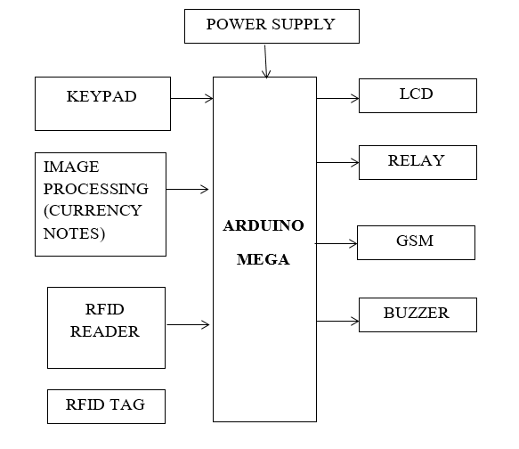
BLOCK DIAGRAM

Slide 10
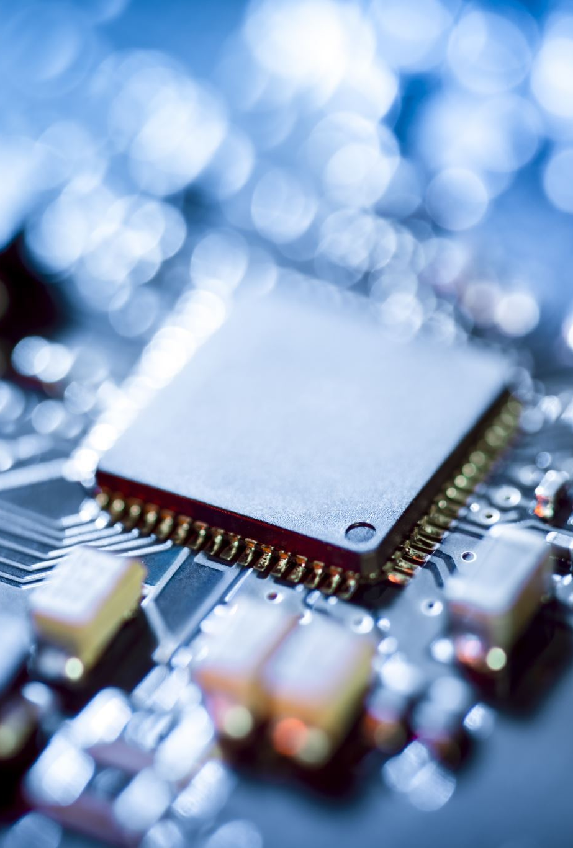
MODULES
Module Name:
Currency accepter module
Identification module

Slide 11
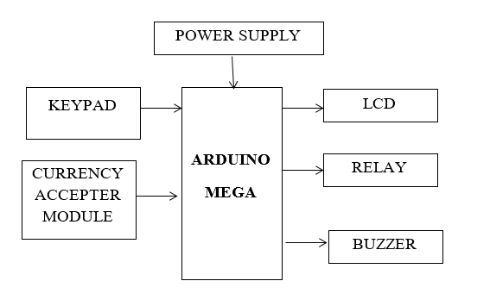
CURRENCY ACCEPTER MODULE
This currency acceptor works by comparing the currency that already inserted in this sensor (blue color at sensor) with the currency that inserted at the front hole.
If the currency is the same, with the inserted then the currency will be accepted, but if the currency is different, the currency will be rejected. Keypad is used to set the amount of money for charging.

Slide 12
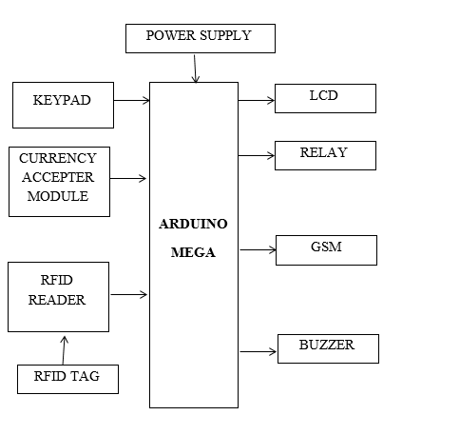
IDENTIFICATION
Using RFID to identify next time you charging, the every time remaining amount will be save RFID card every time. So, we use that money alternate time for charging.

Slide 13





METHODOLOGY/ WORKING
IN THIS PROJECT, WE HAVE USED ARDUINO MEGA MICROCONTROLLER WHICH ACTS AS BRAIN OF OUR SYSTEM, HENCE THE ENTIRE SYSTEM PROGRAM IS STORED IN IT.
HERE THE USE OF THE RFID AND CURRENCY ACCEPTER MODULE WE CAN GIVE THE TWO OPTION FOR THE PAYMENT PURPOSE. THE RFID IS USED TO MAKE A PAYMENT USING CARD AND THE CURRENCY ACCEPTER MODULE IS USED TO MAKE A PAYMENT CARD LESS.
THE KEYPAD IS USED TO GIVE ACCESS TO THE OWNER OF THE EV TO ENTER THE REQUIRED DETAILS INTO THE CHARGING STATION.
GSM MODULE IS USED TO UPDATE PAYMENT INFORMATION FOR THE USER. BUZZER GIVES THE ALERT FOR THE START AND END OF THE CHARGING TIME.
WHENEVER THE PERSON COMPLETED THE PAYMENT RELAY WILL ON AND CHARGING THE VEHICLE WILL START. THE LCD IS USED TO PROVIDE THE USER WITH ALL THE INFORMATION OF THE DEVICE.

Slide 14

HARDWARE REQUIREMENTS
ARDUINO UNO
POWER SUPPLY
LCD
KEYPAD
RELAY
RFID READER
RFID TAG
GSM
BUZZER

Slide 15
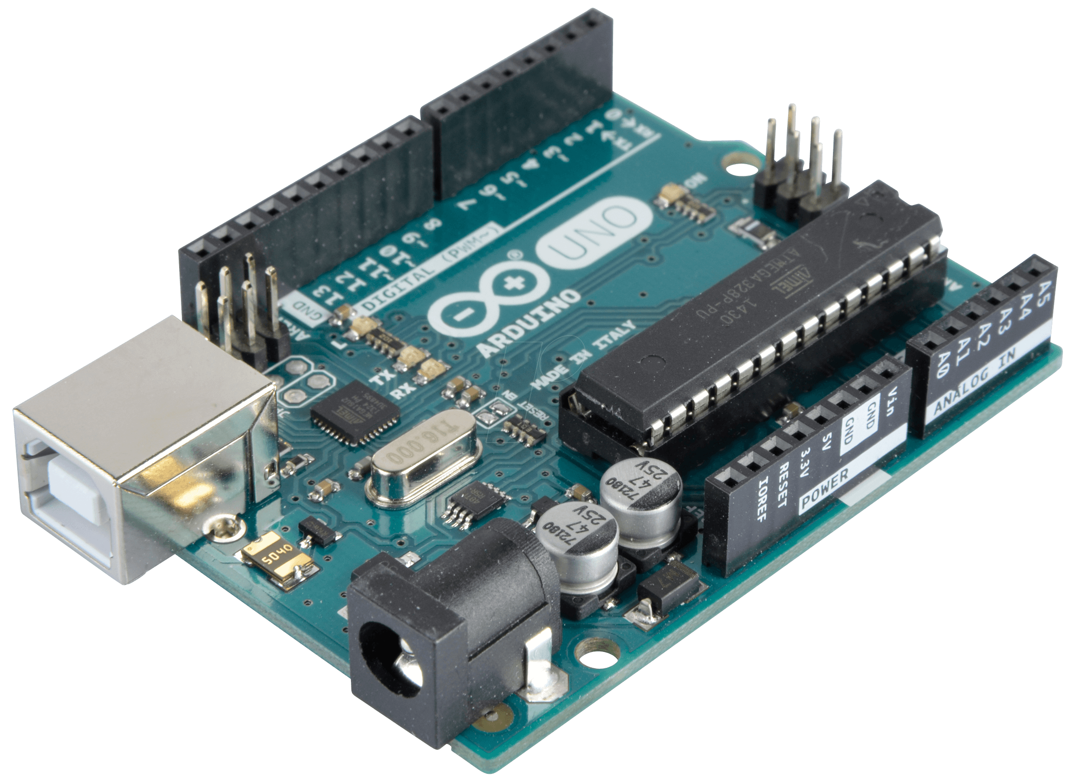
HARDWARE DESCRIPTION
ARUDUINO UNO
Description:
The Arduino Uno is an open-source microcontroller board based on the Microchip ATmega328P microcontroller and developed by Arduino.cc and initially released in 2010.
The board is equipped with sets of digital and analog input/output (I/O) pins that may be interfaced to various expansion boards (shields) and other circuits.
The ATmega328P is an 8-bit microcontroller based on AVR RISC architecture, designed by 8-bit CMOS technology and RISC CPU.
It is one of the most popular AVR controllers, used in ARDUINO boards, and comes with internal protections and multiple programming methods to help engineers prioritize the controller for different situations.

Slide 16
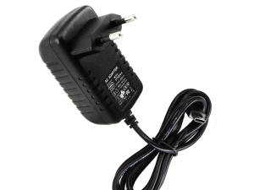
DC ADAPTER
Description:
An electric power adapter may enable the connection of a power plug, sometimes called, used in one region to an AC Power Socket used in another, by offering connections for the disparate contact arrangements, while not changing the voltage.
An AC adapter also called a “recharger”, is a small power supply that changes household electric current from the distribution voltage to low voltage DC suitable for consumer electronics.
Some modify power or signal attributes, while others merely adapt the physical form of one electrical connector to another.

Slide 17
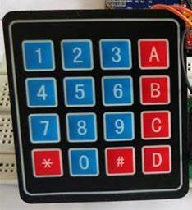
KEYPAD MODULE
Description
A keypad module is an input device that allows users to enter data into a microcontroller or other embedded system.
The 4x4 keypad module consists of 16 keys, which are organized in a matrix of rows and columns.
All these switches are connected to each other with a conductive trace. Normally there is no connection between rows and columns.
When a key is pressed, then a row and a column make contact. The 4x4 keypad module is made of thin, flexible membrane material. The module gives only 8 pins as a way for interacting with 16 buttons.

Slide 18
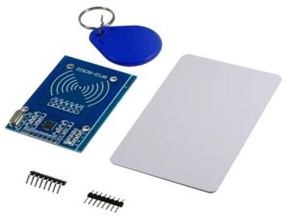
RFID TAG AND READER
Description:
RFID stands for Radio Frequency Identification and is similar to other wireless communication technologies.
It consists of two components: tags and readers.
The reader is a device that emits radio waves and receives signals back from the RFID tag.
Data is stored in the tag electronically and retrieved by the reader using electromagnetic waves. Tags can store only a few kilobytes of data.

Slide 19
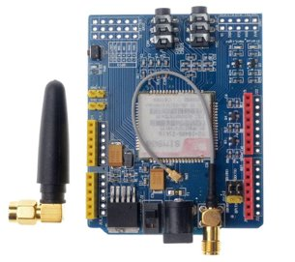
GSM MODULE:
Description
A GSM module is a device that uses the GSM network to connect to other devices. It can add an extra feature for Arduino and other microcontroller projects by giving it access to the extensive mobile network.
The Arduino GSM Shield V1 connects the Arduino to the internet using the GPRS wireless network.
A GSM Module is basically a GSM Modem (like SIM 900) connected to a PCB with different types of output taken from the board – say TTL Output (for Arduino, 8051 and other microcontrollers) and RS232 Output to interface directly with a PC (personal computer).

Slide 20
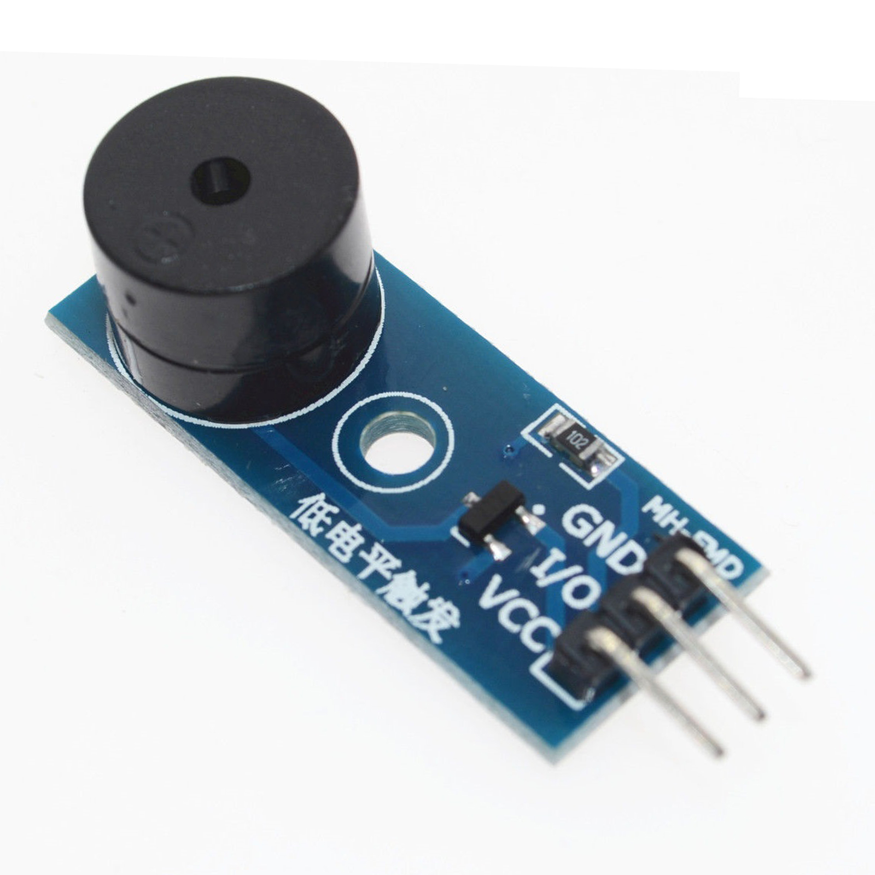
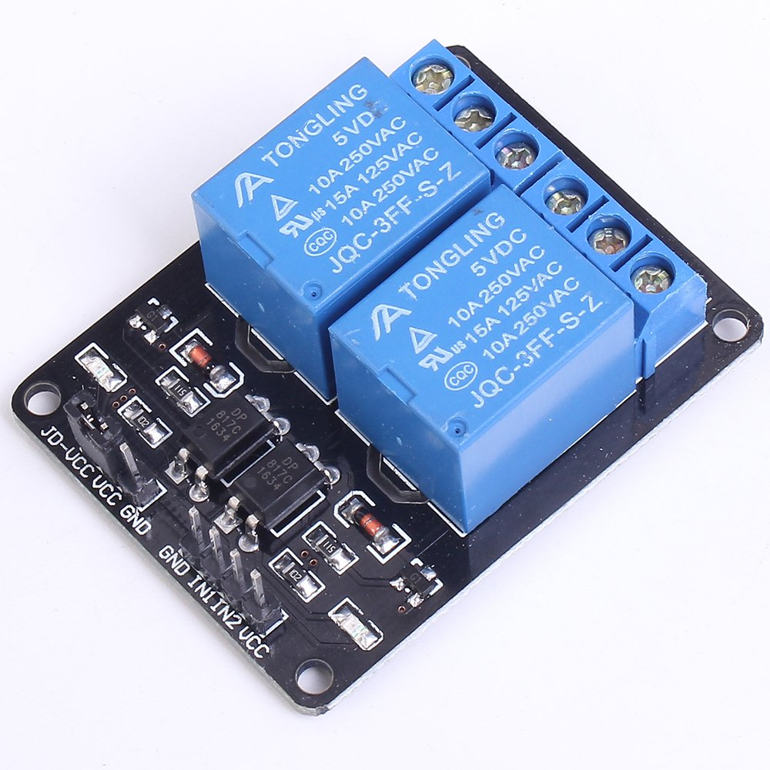
BUZZER AND RELAY
Description.
An Arduino buzzer is a device that produces sound when an electric current is passed through it. It can be connected to an Arduino board and produce different tones by giving different frequency electric pulses to the buzzer.
A relay is a programmable electrical switch used to programmatically control high voltage and/or high current devices, using 5V output from an Arduino pin to energize an electromagnet and close an internal switch.

Slide 21
SOFTWARE REQUIREMENTS
EMBEDDED C
ARDUINO IDE

Slide 22

SOFTWARE REQUIREMENT
ARDUINO IDE
Arduino is an open-source electronics platform based on easy-to-use hardware and software.
Arduino boards are able to read inputs - light on a sensor, a finger on a button, or a Twitter message - and turn it into an output - activating a motor, turning on an LED, publishing something online.

Slide 23
EMBEDDED C
Embedded c is designed to bridge the performance mismatch between standard c and the embedded hardware and application architecture.
It extends the c language with the primitives that are needed by signal-processing applications and that are commonly provided by dsp processors.
The design of the support for fixed-point data types and named address spaces in embedded c is based on dsp-c. dsp-c [1] is an industry-designed extension of c with which experience was gained since 1998 by various dsp manufacturers in their compilers.
For the development of dsp-c by ace (the company three of us work for), cooperation was sought with embedded-application designers and dsp manufacturers.
The embedded c specification extends the c language to support freestanding embedded processors in exploiting the multiple address space functionality, user-defined named address spaces, and direct access to processor and i/o registers.

Slide 24
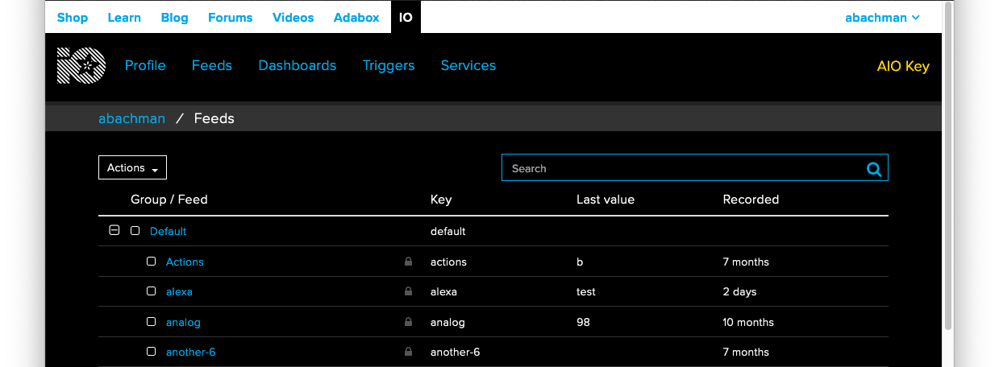
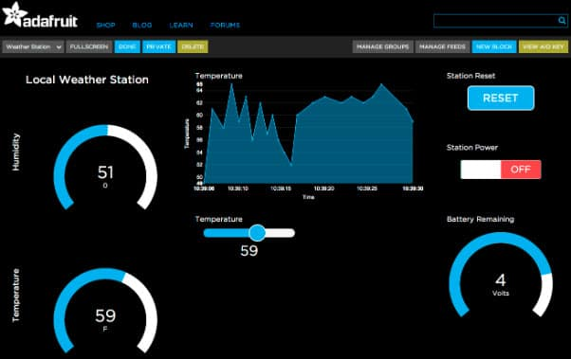
ADAFRUIT INTERFACE
Adafruit IO with the MQTT protocol is used on the Arduino, because you can use the Adafruit MQTT Arduino library to control it easily.
This is a general-purpose MQTT library for Arduino that's built to use as few resources as possible so that it can work with platforms like the Arduino Uno.
The Adafruit IO Arduino library is a simple library for sending and receiving the latest value for a feed.
Adafruit IO also has a web interface as seen below.

Slide 25
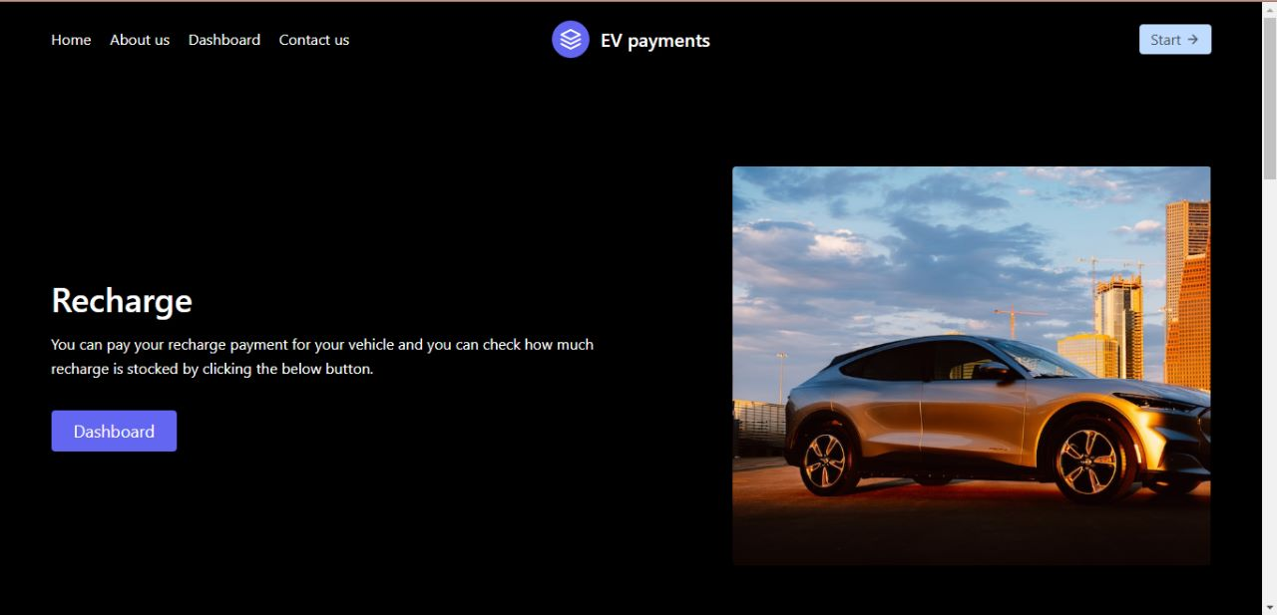
USER INTERFACE AND DASHBOARD

Slide 26
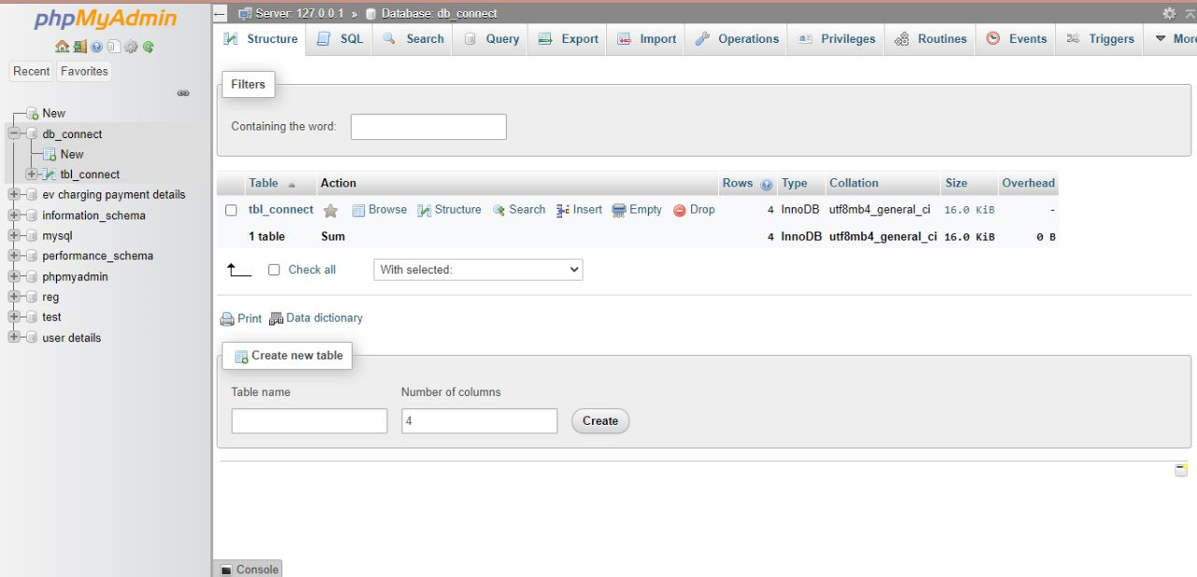
For Database purposes we are using phpMyAdmin

Slide 27
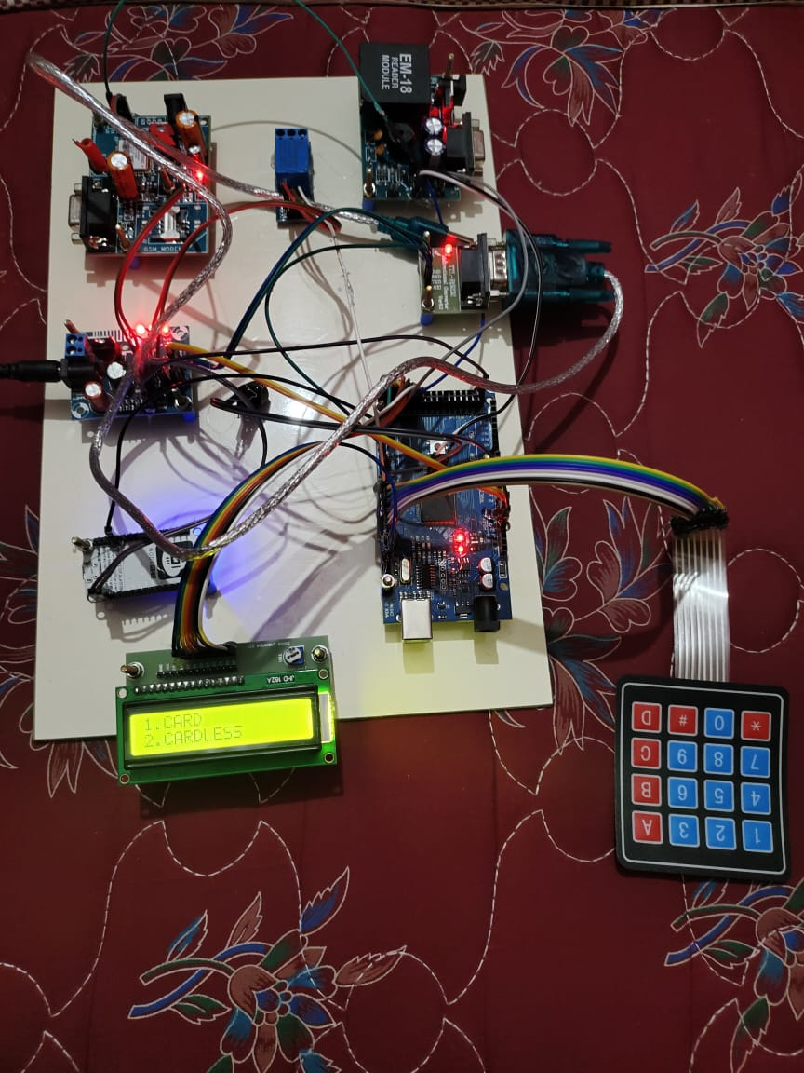
With card transaction.
By selecting 1 from the keypad, We can choose the card option.

Slide 28
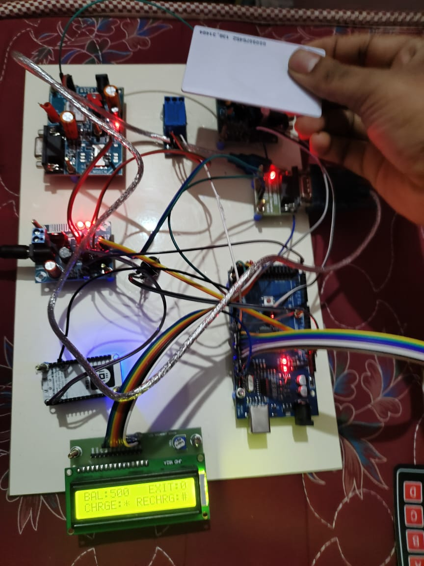
The RFID reader reads the card and shows us the balance of its card details

Slide 29
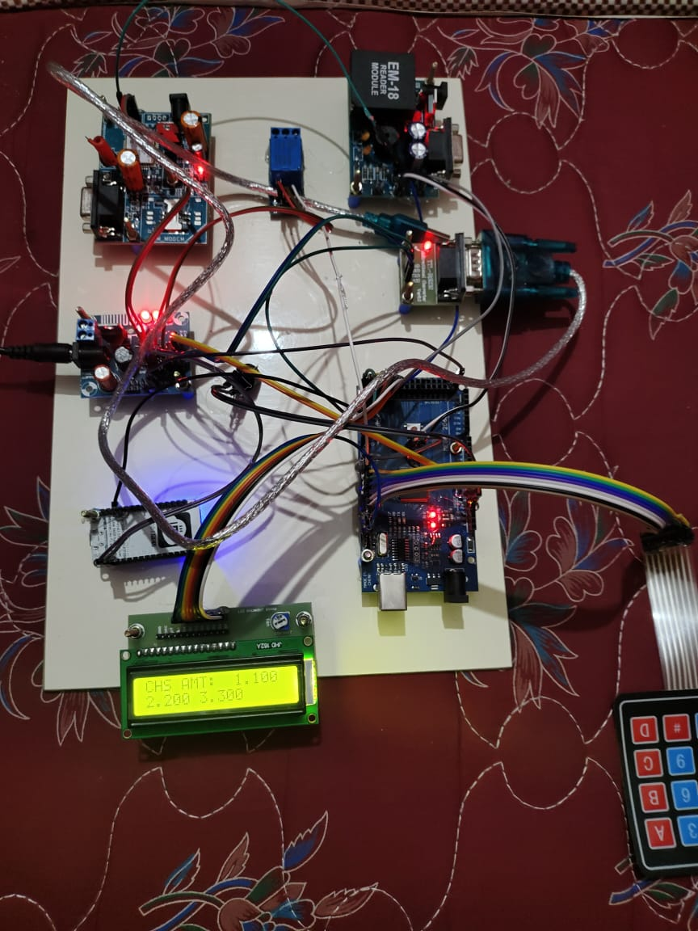
After reading card the machine shows us the card balance as below.

Slide 30
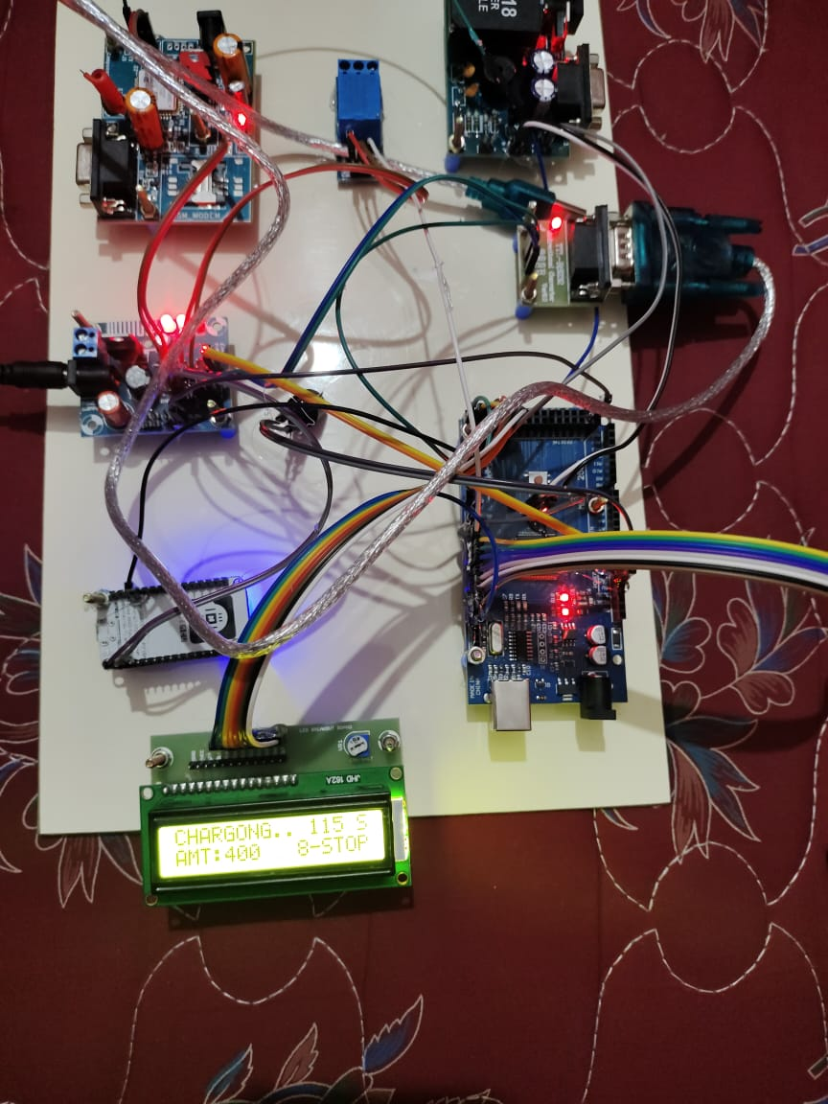
Charging through relay

Slide 31
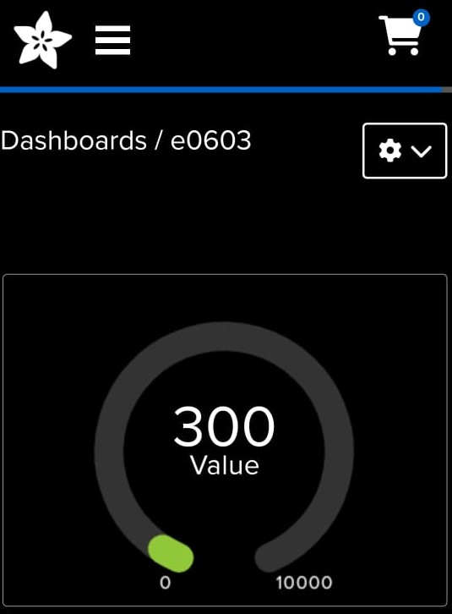
IOT Dashboard

Slide 32
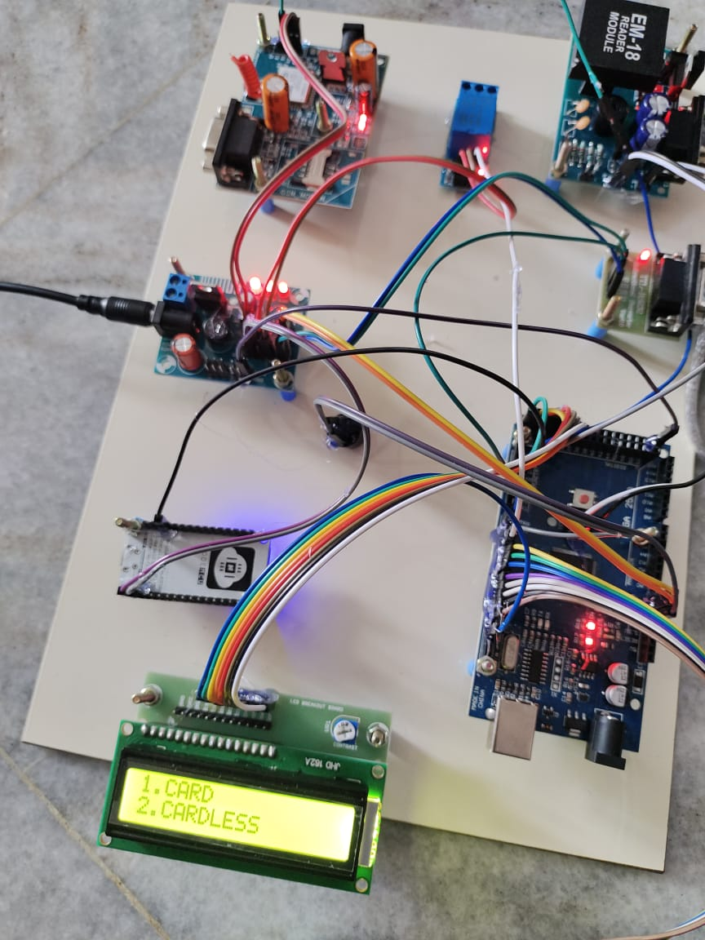
Without card transaction
By pressing 2 in hardware we can go to cardless transaction.

Slide 34
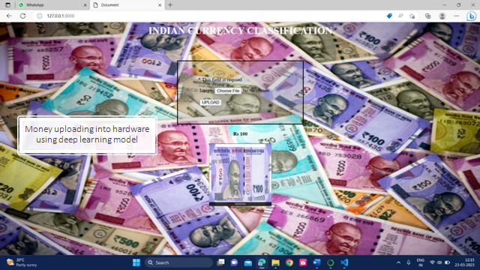

Slide 35
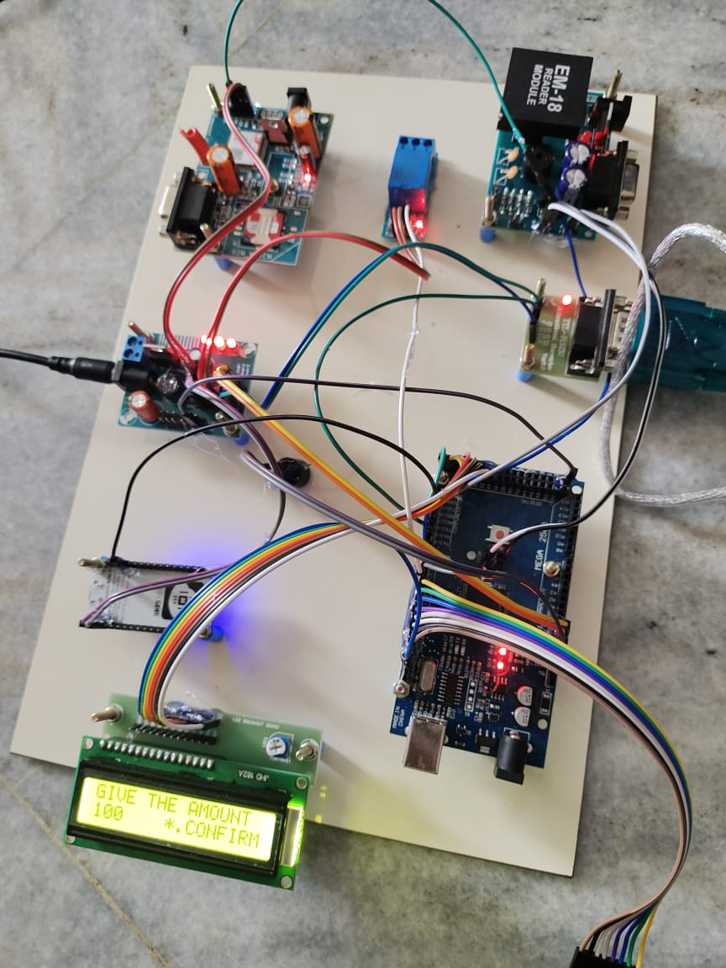
Money uploaded into hardware

Slide 37
CONCLUSION:
In conclusion, user-friendly AI hardware for EV charging using RFID is a promising solution for the challenges faced by electric vehicle owners. The implementation of RFID technology allows for easy and efficient charging processes by providing a convenient payment system and eliminating the need for physical cards.
With the incorporation of AI technology, the charging process can be optimized to cater to the individual needs of the user, including energy-efficient charging and accurate billing. The use of user-friendly hardware and software improves the usability and accessibility of electric vehicle charging stations, ultimately contributing to the success and adoption of sustainable mobility solutions.
Therefore, the integration of user-friendly AI hardware for EV charging using RFID technology should be prioritized in the development of EV charging infrastructure.

Slide 38
REFERENCE:
[1] Chen W. R., Dai C. H., Li q., Ma L., Wang T. H., and “power management strategy based on adaptive droop control for a fuel cell battery – super capacitor hybrid tramway,” IEEE transactions on vehicular technology, vol. 67, no. 7, pp. 5658–5670, jul. 2018.
[2] Chen W. R., Huang W. Q., J. W. Liu, Li Q., Yan y., and “ hierarchical management control based on equivalent fitting circle and equivalent energy consumption method for multiple fuel cells hybrid power system” IEEE transactions on industrial electronics, vol. 67, no. 4, pp. 2786–2797, apr. 2020.
[3] Chen W. R., Han Pu, Y., Li q., Su B., Wang Y. C. T. H., Yin L. Z., and “A state machine control based on equivalent consumption minimization for fuel cell/super capacitor hybrid tramway,” IEEE transactions on transportation electrification, vol. 5, no. 2, pp. 552–564, jun. 2019.
[4] Chen W. R., Li J. C., Li Q., Liu M., Meng X., Qiu Y. B., Wang t. H., Wang X. T., and “an optimized energy management strategy for fuel cell hybrid power system based on maximum efficiency range identification,” journal of power sources, vol. 445, pp. 227333, jan. 2020.
[5] Chen S., Chen L., and Ma D. Z., Sun q. Y., “quasi-z-source network based hybrid power supply system for aluminum electrolysis industry,” IEEE transactions on industrial informatics, vol. 13, no. 3, pp. 1141– 1151, jun. 2017.

Slide 39

Thank You

